Slide 1

[1]
CHERUBIM
COMING SOON FROM A HEAVEN NEAR YOU
Greg Campbell
University of California – Irvine
Web Dev Boot Camp
October 30, 2018

Slide 2

Genre & Rating
Puzzle Game
Parody Game
E Rating
Mild Cartoon & Fantasy Violence, Comic Mischief
[2]

Slide 3
Target Audiences
Primary
Frequent video game players familiar with a variety of genres and pop culture who enjoy puzzle games and comedy, ages 27-30.
Secondary
All fans of puzzle games, cartoons, and comedy, ages 6+.

Slide 4

Platforms & Tech
Primary Platforms
PC, Mac, Ubuntu Linux
Secondary Platforms
Xbox, PlayStation, Wii, iOS, Android/Ouya,
2DS/3DS, PS Vita, every other platform we can
Technology
Unity
[14]

Slide 5
Game Concept
Basic Mechanics
-Real-time team-based puzzle game
-Free movement
-Goal: All units much reach level exit
-Other required/optional objectives by level
Aesthetic
-Humorous
-Cutesy anime
-Angelic

Slide 6
Story in Brief
Im’s Birthday
Im & Fellow Angels Go on Journey
Angels Return Home
Angels celebrate Im’s birthday properly
Notes:
The game starts with Im and his twin brother Tony celebrating Im’s birthday. Im’s birthday wish is to go on a fantastic adventure – and he soon gets it!
After noticing attendance is remarkably low (it’s only Im and Tony), Im tells Tony about his most amazing dream, that his birthday wish came true! Im convinces Tony to go exploring with him in Nimbia (their heavenly home). The two eventually explore the world – Nimbia, the mines below, outer space, and the Abyss – and eventually return to their heavenly home with everyone originally invited to Im’s birthday party. Many jokes are made, pop culture sources are parodied, and much fun and joy are had by all (including the player!)

Slide 7
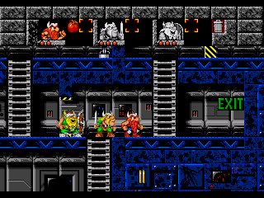
Inspirations
The Lost Vikings (PC, 1993)
-Team-Based Platforming Puzzle Game
-Character Control
-Character Abilities
-Level Exits
-Comedic
[3]

Slide 8
Reference Video
The Lost Vikings (PC, 1993)
https://www.youtube.com/watch?v=eNuiBNCCiZs
Gameplay begins at 15 seconds.

Slide 9
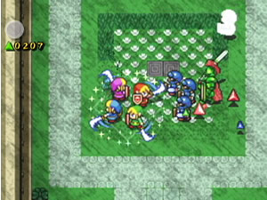
Inspirations
Four Swords Adventures (GameCube, 2004)
-Simultaneous 4P Team-Based Chaotic Fun
-Minor Inventory System
-Hilarious In Action
-Cutesy Anime Art
-Light-Hearted
-Puzzle-Heavy
[13]

Slide 10
Reference Video
Four Swords Adventures (GameCube, 2004)
http://youtu.be/SA790Bas7YU?t=24s
Gameplay begins at 24 seconds.

Slide 11
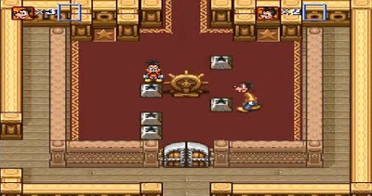
Inspirations
Goof Troop (SNES, 1993)
-2D Orthogonal Perspective
-Cartoon Art Style
-Comedic
-Simultaneous
2 player
Puzzle Game
[12]

Slide 12
Reference Video
Goof Troop (SNES, 1993)
https://www.youtube.com/watch?v=Fg0SuolafHg
Gameplay begins at 30 seconds.

Slide 13
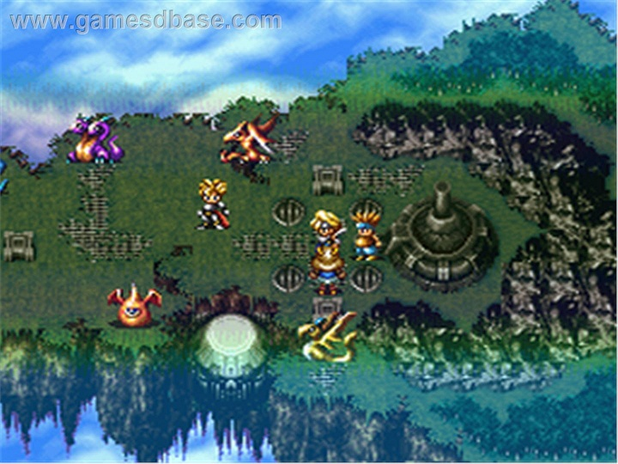
Inspirations
Bahamut Lagoon (SNES, 1996)
-Anime Art Style
-2D Isometric Perspective
-Some Units Can Fly
[4]

Slide 14
Reference Video
Bahamut Lagoon (SNES, 1996)
https://www.youtube.com/watch?v=Ex1LDiRuuZE&list=PLp2Nh_aH_HKMhJtidyFd9xO2ClTBnncFv
Gameplay begins at 9 minutes and 40 seconds.

Slide 15
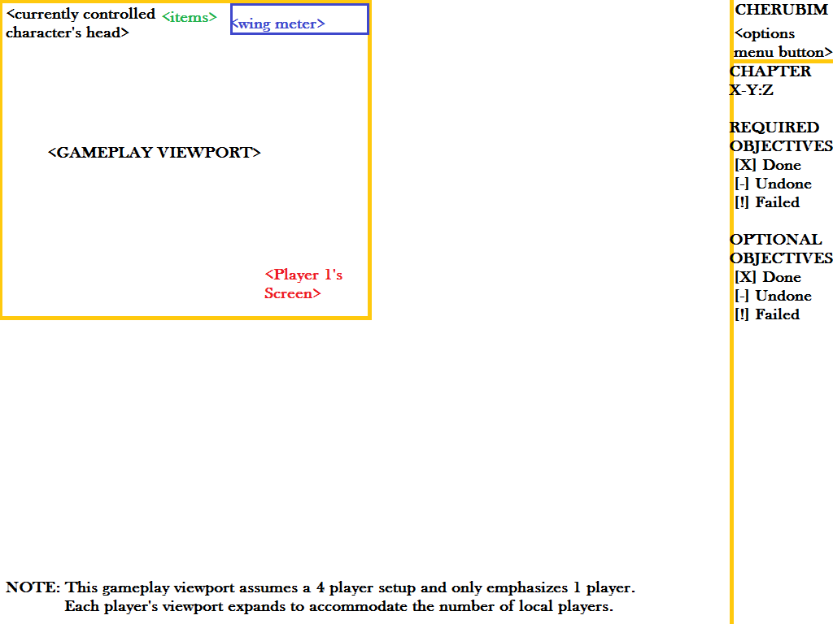
Interface Mockup 1 (PC)
Notables
-Wing Meter
-Interface
varies by
Platform
-Xbox 360
Controller

Slide 16
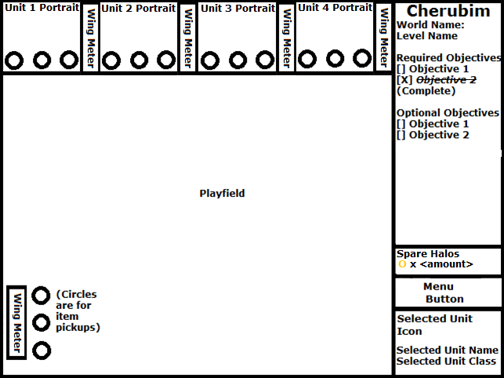
Interface Mockup 2 (PC)
Notables
-Wing Meter
-Interface
varies by
Platform
-Xbox 360
Controller
[10]

Slide 17
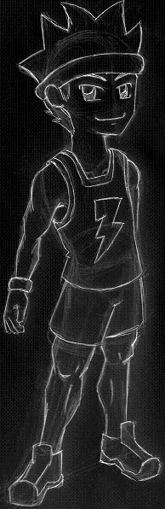
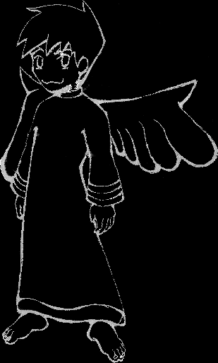
Look & Feel
Feel
-Humorous
-Light-hearted
-Fantastic
Look
-Cutesy
-Anime
Im Concept [5]
Russel Concept [6]

Slide 18

Look & Feel
Feel
-Humorous
-Light-hearted
-Fantastic
Look
-Cutesy
-Anime
Gate & Im Scale Concept Colored!

Slide 19
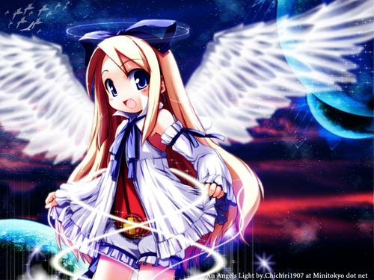
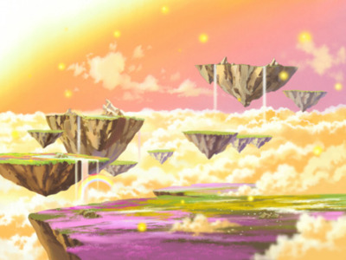

Look & Feel
Nimbia Environment Concept
[8]
Basic Cherub Concept
[7]
Main Character Face Concepts
[11]

Slide 20
Sample Puzzles
Ask Me For Details!

Slide 21
Q & A
Notes:
This slide is fine.

Slide 22
References
[1]: Campbell, Greg. 2007. Cherub Gender Icon. [Illustration].
[2]: ESRB. 2013. E for Everyone. Retrieved from http://herinteractive-
amateursleuth.blogspot.com/2013/05/never-too-old-for-nancy-drew.html
[3]: Drat. 2006. Lost Vikings Level 1 Exit. Retrieved from
http://en.wikipedia.org/wiki/File:TheLostVikings.png
[4]: Games Database. 2014. Bahamut Lagoon Second Fight. Retrieved from
http://gamesdbase.com/game/nintendo-snes/bahamut-lagoon.aspx
[5]: Beal, Becky. 2007. Basic Cherub Concept Sketch. [Illustration].
[6]: Beal, Becky. 2007. Athlete Cherub Concept Sketch. [Illustration].
[7]: Chichiri1907. 2010. Flonne Wallpaper. Retrieved from
http://hqwall.net/eng/wallpaper/disgaea%20flonne
%20haga%20yui%20planet%20wings%2048-141057.html
[8]: Makai Senki Disgaea RP. 2011. Celestia Background – From Disgaea. Retrieved
from http://gendou.com/t/27112

Slide 23
References
[9]: DownloadShortcut. 2014. GameMaker: Studio Logo. Retrieved from
http://downloadshortcut.blogspot.com/2014/02/free-download-game-makerstudio- master.html
[10]: Campbell, Greg. 2014. Cherubim Preliminary Single Player Interface. [Illustration].
[11]: Alvies, J. 2014. Ramza Beoulve Face Icons. Retrieved from
http://www.cavesofnarshe.com/fft/characters.php?character=Ramza
[12]: Nerdstrom, M. 2011. Top 50 SNES Games Part 4. Retrieved from
http://nerdhistory101.blogspot.com/2011/09/top-50-snes-games-part-4.html.
[13]: GR_Chimp. 2004. The Legend of Zelda: Four Swords Adventures Review.
Retrieved from http://www.gamerevolution.com/review/zelda-four-sword.
[14]: Unity3D. 2013. Unity3D Logo Back Background. Retrieved from
http://www.ghostofatale.com/tag/unity/

